Slide 1

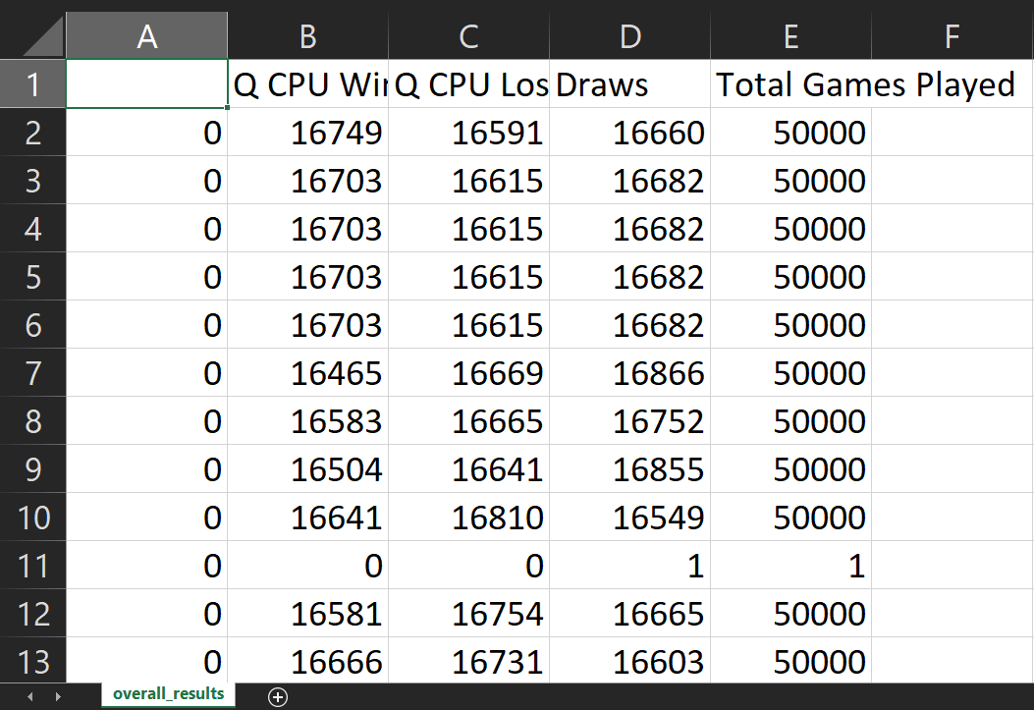

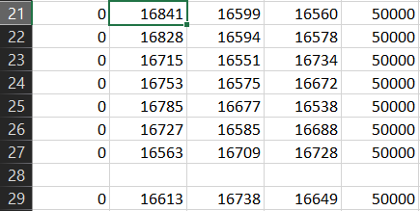
Q-Reinforcement Learning Rock, Paper, Scissors – Amari Lawal
Summary
GitHub Repo: https://github.com/Amari-Lawal/Baes-System-Project.git
My projects goal was to implement q-reinforcement learning into the rock paper scissors game. What does this jargon mean you must be thinking?
The program creates a CPU bot/agent that learns how to play rock paper scissors as it plays, as a result making an unstoppable player that will always beat you for the last slice of pizza at a party!
A problem I came across was that the same values were being produced. Which is anomalous for an algorithm that runs off of randomness.
I solved it by shuffling the data in order to change the order of moves.
However the Q CPU would constantly lose for the next few games.
After a few more games the Bot managed to win most of its games of rock paper scissors. With a good consistency.
During the project, I oddly enjoyed the longer run times in my code. It made me feel like I was building this super sophisticated system, yet it was a simple rock paper scissors game. Whilst at the same time withheld considerable complexity.

Slide 2

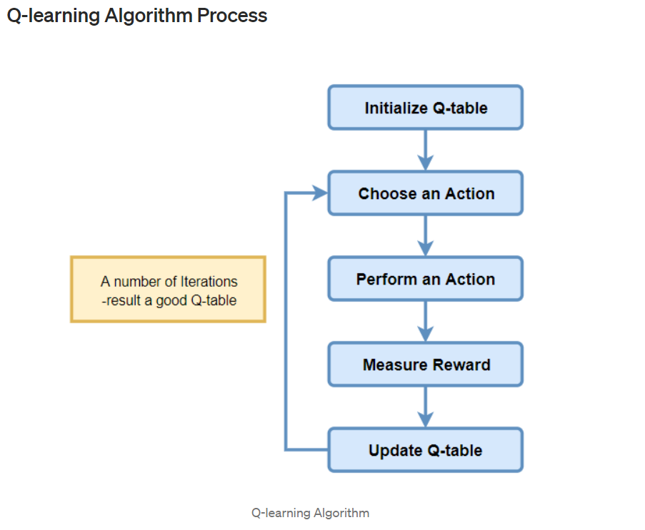
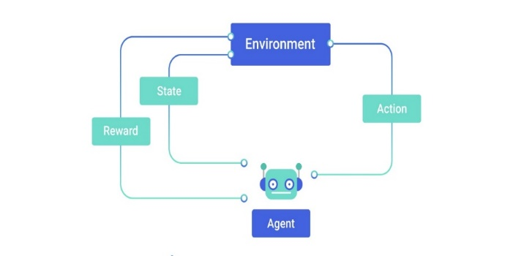
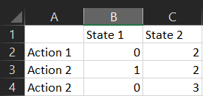
Q-Reinforcement Learning Rock, Paper, Scissors – Amari Lawal
Research
During the research process I learned the mathematical processes that occur when creating a reinforcement learning Agent. I learned the fundamentals in implementing this into my game.
Before this program, I was initially intimidated to learn reinforcement learning because there was a lot more code, maths and a better understanding of the techniques required in order to learn it than other techniques. With very minimal documentation.
From articles and research papers I learned that to make an agent learn there are certain steps require.
Firstly you initialize the Q table:
The Q table is simply a log of all moves made in the game
State1 – player turn, State2 – CPU turn
Action – Rock, Paper Scissors
Q table
Research Infromation
I used this site to help me understand the theory and how to use the algorithm equation:
https://towardsdatascience.com/a-beginners-guide-to-q-learning-c3e2a30a653c
And several research papers:
Google Scholar: q learning reinforcement learning
Rock = 0
Paper = 1
Scissors

Slide 3

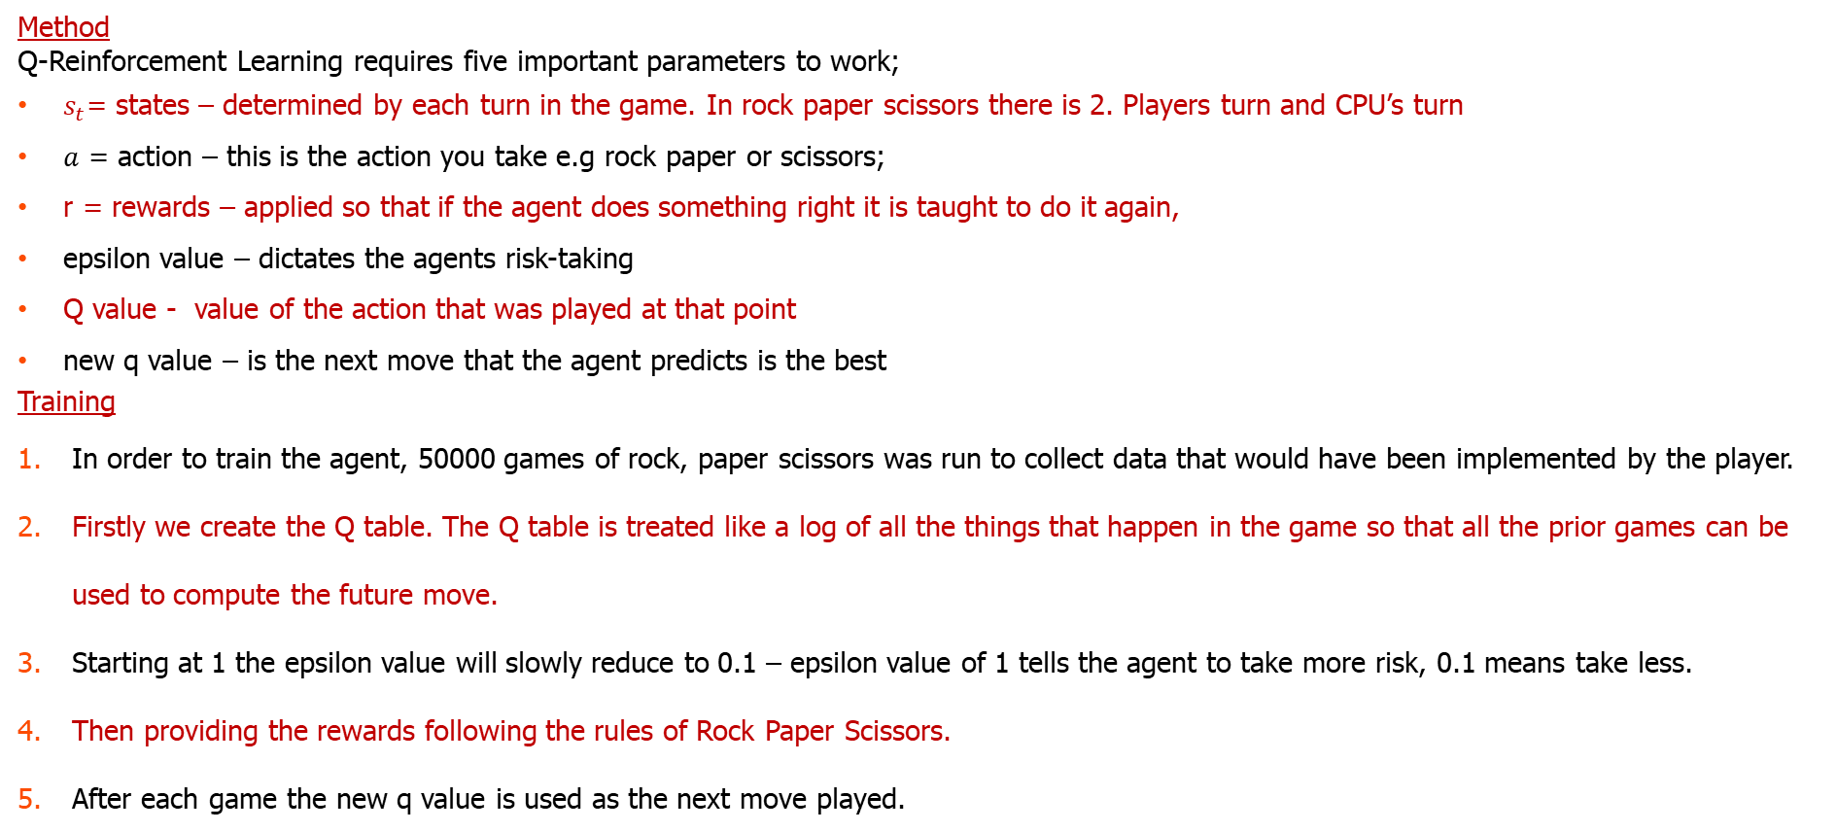
Q-Reinforcement Learning Rock, Paper, Scissors – Amari Lawal
Method
Q-Reinforcement Learning requires five important parameters to work;
$s_{t}$= states – determined by each turn in the game. In rock paper scissors there is 2. Players turn and CPU’s turn
$a$ = action – this is the action you take e.g rock paper or scissors;
r = rewards – applied so that if the agent does something right it is taught to do it again,
epsilon value – dictates the agents risk-taking
Q value - value of the action that was played at that point
new q value – is the next move that the agent predicts is the best
Training
In order to train the agent, 50000 games of rock, paper scissors was run to collect data that would have been implemented by the player.
Firstly we create the Q table. The Q table is treated like a log of all the things that happen in the game so that all the prior games can be used to compute the future move.
Starting at 1 the epsilon value will slowly reduce to 0.1 – epsilon value of 1 tells the agent to take more risk, 0.1 means take less.
Then providing the rewards following the rules of Rock Paper Scissors.
After each game the new q value is used as the next move played.
$∆$difference state change
$$Q^{new}\left(s_{t},a_{t}\right)=Q\left(s_{t},a_{t}\right)+α ∙(r+ γ+\max{Q\left(s_{t+1},a\right)}−Q(s_{t},a_{t})$$
new Q value
old Q value
reward
learning rate
old Q value
discount factor
estimate of future value

Slide 4
Q-Reinforcement Learning Rock, Paper, Scissors – Amari Lawal
Future Plans
After this program I have developed the interest to explore reinforcement learning further so that I can escalate to researching into creating games, software and engines with higher complexity.
In order to complete more complex tasks, in a way that has value to the world and advancement. Using these skills for both my own recreation and in the work place.
My interest has always been in machine learning for cybersecurity and applying to this program has helped me to learn how best to integrate the two and to implement good research to further learn more.
In the hopefully near future, I’m looking forward to potentially working with you all in the future and working with baes systems in the working world.
Hopefully applying to the apprenticeship at the end of sixth form in cybersecurity and machine learning, I could further learn more and to work with many more people in baes systems in the real-world situations and problems.
Thank You For Listening!!!

